Slide 1
2019 Budget Review

Slide 2
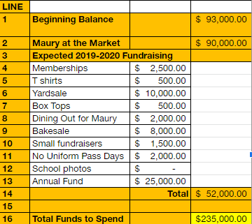
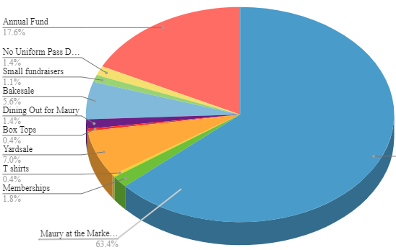
2019 – 2020 Income

Slide 3
Maury @ the Market
 | 2018 | 2019
Income | $115,395.45 | $110,970.59
Expense | $9,104.95 | **$16,420.27
Net | $106,290.50 | $94,550.32
 |  | Greater Giving 2950 2018 Maury @ Market Expense 1100 2018 Maury @ Market Expense 530 2018 Maury @ Market Expense 750 2020 Maury @ Market Expense 1100 ___________ $6,430

Slide 4
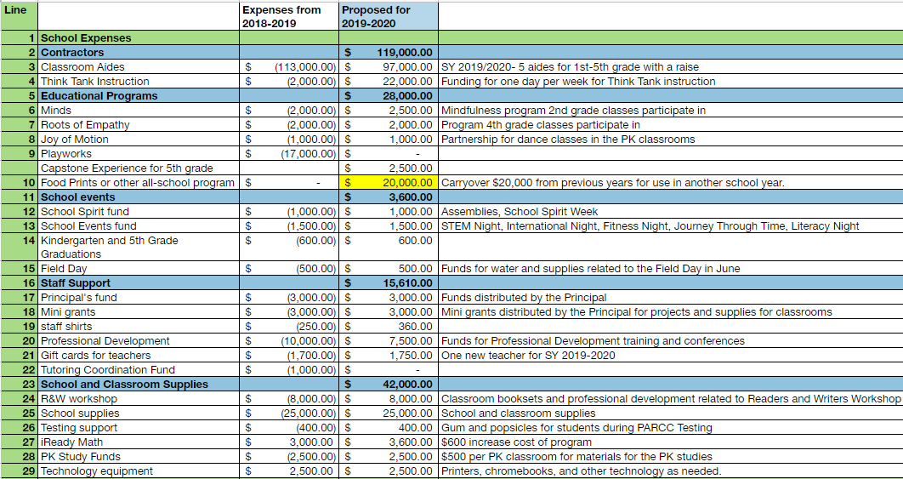
2019 – 2020 Expenses

Slide 5
2019 – 2020 Expenses

Slide 6
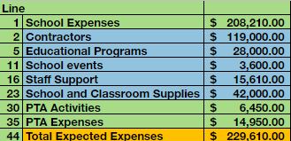
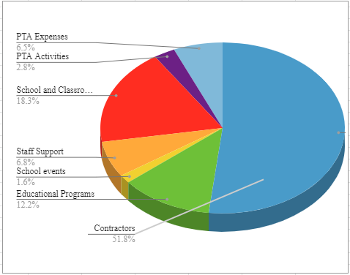
2019 – 2020 Expenses

